Slide 1
LECTURER: DR. O.B. OKEDERE
TITLE: INDUSTRIAL ECONOMICS
CODE: CVE511
DEPT/FACULTY: CIVIL ENGINEERING/ FACULTY OF ENGINEERING & ENVIRONMENTAL SCIENCES
SEMESTER/SESSION: HARMATTAN 2019/2020

Slide 2
OUTLINE/DESCRIPTION
Law of management economics, management models, revenue of the firms, production decision, cost of production, profit analysis of the firms, pricing techniques location and localization of industries, industrial growth in Nigeria, the size of the firm integration and diversification marketing; demand and forecasting. Distributive trade in Nigeria, business finance, investment, capital budgeting and management control. Government policies and firm. Financing Technology: Capital equipment investment appraisal methods. Break even analysis. Budgeting and financial control. Fundamentals of cost accounting with emphasis on production costing. Areas of conflicts between Engineering valuation. Management: Organzational structure and behavior, engineer to engineer manager transition, managerial functions, principles and techniques of planning, forecasting organizing technical activities, project selection and management, style of leadership and management techniques.

Slide 3
COURSE OBJECTIVES

Slide 4
Week 1: Managerial Economics and Management Models
The serious gap between logic and economic theories have to be bridged in order to allow managers and chief executives arrive reliable and well informed practical decisions that will guide policy directions.
The merging of economic theories and methodology with analytical tools for decision making in allocation of resources whether at private or public sector level is the reason for Managerial Economics- K.K. Seo and B.J. Winger

Slide 5
Managerial economics is concerned with the application of economics concepts and economic analysis to the problems of formulating rational managerial decisions. (Mansfield)
It is a discipline that combines economic theories with managerial practices and helps to recover the gap between the problem of logic and policy.

Slide 6
The most important function in managerial economics is decision making. It involves selecting the most suitable action from two or more alternatives.
Economic theories and analysis are used to solve problems of managerial economics.

Slide 7
Economics comprises two main divisions; micro and macro economics
Microeconomics covers the analysis of small individual units of economy such as individual firms, industry or a single individual consumer while macroeconomics deals with the study of the entire economy and considers all factors such as government policies, GDP national income, unemployment etc.

Slide 8
Management Models
Classical Management theory:
Here, emphasis is laid on structure, prescription of what is good for the firm and practical approach to management. Among the proponents of this approach was Henri Fayol. Some of the highlights of this model include:
Division of Work
Authority: The right to give order should be based on responsibility

Slide 9
Discipline: Respect for formal and informal agreement between employer and employee
Unity of Command: There must be a superior
Unity of Direction
Subordination of Individual to General interest
Fair Remuneration
Centralization

Slide 10
Human Relations Theory
As against structure and mechanics of organisation which are to focal points of classical model; human relation theory emphasizes human factors- motivation, group motivation and leadership. The theory affirms that meeting people’s need is germane in organizational effectiveness
Neo- Human Relations Theory:
Management is viewed from social – psychology perspective. The focus on human motivation includes satisfaction, incentive, intrinsic etc

Slide 11
System Theory
Here, an organization is viewed as systems with a number of inter-related sub-systems. It is an attempt to merge classical approach with the human relation approaches that focus on the psychological, social and human needs

Slide 12
Demand and Supply between individuals
Total Economic environment
Consumers,
Buyers,
Vendors
Studies related to local, regional and global economics
All the economic theories, tools and concepts are covered under the scope of managerial economics

Slide 13
Week 2: Concept of Demand and Supply
Demand means the ability and willingness to buy a specific quantity of a commodity at a given price and at a particular time.
Law of Demand states that the quantity of a commodity demanded in a given time period increases as price falls, other things being equal (Ceteris paribus)

Slide 14
Demand Schedule:
This is a table showing the quantity of goods that a consumer is willing and able to buy at a prevailing price in a given period of time.

Slide 15
Demand Schedule
Price | Quantity Demanded
50 | 1
45 | 2
40 | 3
35 | 4
30 | 7
25 | 12
15 | 15

Slide 16
Demand Curve: It is a curve indicating the total quantity of a product that consumers are willing and able to purchase at the prevailing price level holding the price of related goods, income and other variables constant.
Price (Y – axis)
Demand curve
Quantity Demanded (x – axis)

Slide 17
Shift in Demand
A shift in demand occurs when the determinants of demand change. When taste, preferences and income are altered, the basic relationship between price and quantity demanded changes (shifts). The shift in the entire demand curve upward and is called increase while a downward shift is called decrease in demand.
D₁
D
D_{o}
Price
D₁
D
D_{o}
Quantity Demanded

Slide 18
The movement along a demand curve can take place due to price rise or fall. When price falls, more of the commodity is purchased and vice versa.
D
P₁
a
P
b
Price
P_{O}
c
D
Q₁
Q
Q_{O}
Quantity Demanded

Slide 19
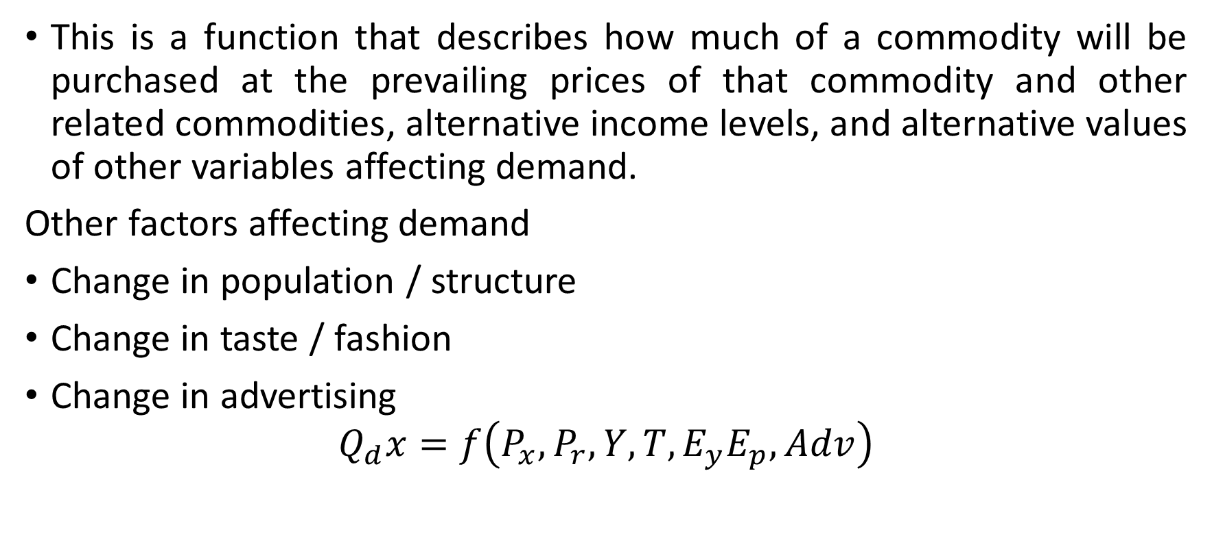
Demand Function

Slide 20
Factors affecting Demand
Price of Goods
Price of related goods (Substitute / complementary goods)
Income
Population
Value of Money
Weather condition
Advertisement
Expectation of future change in price

Slide 21
Factors affecting Demand
Government policy (taxation)
Availability of credit facilities
Multiplicity of users

Slide 22
Types of Demand
Direct and Indirect
Derived and autonomous
Durable and non durable goods demand
Firm and Industry demand
Total market / Segment demand
Short run / Long run demand
Joint / Composite demand
Price demand / Income demand / Cross demand

Slide 23
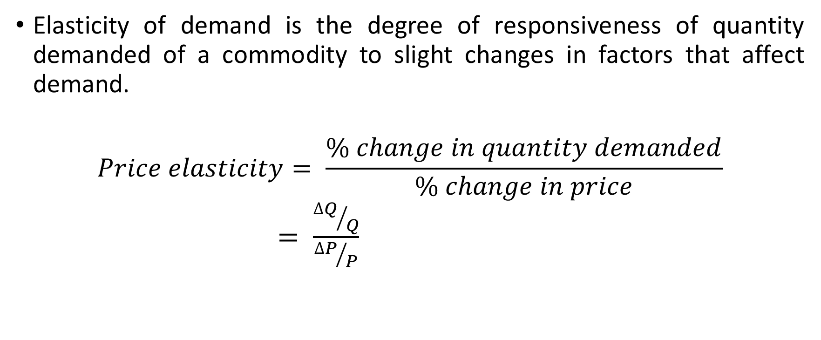
Elasticity of Demand

Slide 24
Cross Elasticity
Cross Elasticity = Percentage Change in Quantity Demanded of A/ Percentage Change in Price of B
Theories of elasticity is useful in making decisions on:
Production
Price Fixation
Distribution
International Trade
Public Finance

Slide 25
Example
The demand for a product rises from 500 units to 600 units where the price of a particular product reduces from N25 000 to N22 000. Find the cross elasticity of demand for the two products. What is the nature of their relationship?

Slide 26
Week 3: Production
Definition
The principal aim of any economic activity is creation of utility (satisfaction); hence, all activities that provide utility or which assist to provide satisfaction in the future time are regarded as production. Firms are involved in production processes and they refer to entities created by persons to organize and spur production. A firm makes use of factors of production to transform resources into good and services and which eventually create utility.

Slide 27
Types of Production
Primary Production: This is done by extractive industries like agriculture, mining, oil industry. The activities involve extraction of ores and other natural resources from beneath the earth crust, water bodies etc.

Slide 28
Secondary Production: This is largely manifested in manufacturing activities in the various industries involved in making finished and semi finished products from crude materials.

Slide 29
Tertiary Production: The production activities involved here include all services which cause finished goods to reach final consumers. Activities in this category include warehousing, wholesales, retailing, haulage, communication, banking, insurance, law, health etc

Slide 30
Factors of Production
These are resources that are combined together to achieve creation of utility. Each Factor gets rewarded based on its contribution to the production process. These factors include:
Entrepreneur:
An individual or group of individuals which forms an entity called firm. The reward of an enterprise or entrepreneur is profit. This factor is concerned with decision making, management control, division of income, risk taking and bearing of uncertainties, innovations etc

Slide 31
Capital:
These are man made resources whose rewards manifest as interests. They can be classified as fixed or circulating.
Land: Refers to any natural resource. The reward of land is rent. The supply of land is limited although reclamation is possible in some sense. Although fixed in supply, lands have alternative uses. Land is not homogenous and values vary from place to place. It may be subject to diminishing returns and it is not mobile.
Labour : These are skilled and unskilled persons employed to create utility and whose rewards manifest as wages

Slide 32
Weeks 4&5: Cost, Revenue & Break- Even
Concept of cost can be theoretically grouped into two over-lapping categories:
Concepts used for accounting purposes; and
Analytical cost concepts used in economic analysis of business activities.

Slide 33
Accounting cost concept
Opportunity cost and actual or explicit cost: Oportunity cost is the expected returns from the second best use of an economic resource while actual costs are those out of the pocket costs of labour, material, machine, plant building and other factors of production.

Slide 34
Business and Full Costs: Business cost are all expenses incurred in carrying out business while full cost include: business cost, opportunity cost and normal profit.
Explicit and Implicit costs: Explicit costs are cash payments recorded in accounting practices such as wages, salaries, etc. while implicit cost are the cost that do not appear in business accounting system.

Slide 35
Analytical cost concept
Fixed and Variable costs: Fixed costs are costs that remain fixed in volume for a certain level of output while variable costs vary with variation in output. They include cost of raw materials.
Total, Average and Marginal costs: Total cost refers to the total expenditure on the production of goods and services. Average cost is obtained by dividing the total cost by the output Q, while marginal cost is the additional cost of producing one extra unit of a product.

Slide 36
Short Run and Long Run costs: Short run costs change as desired output changes given a constant size of firm, while long run costs are costs incurred on firm’s fixed assets such as plant, machinery and buildings, etc.
Other costs include: Incremental and sunk costs, Historical and replacement costs, private and social costs

Slide 37
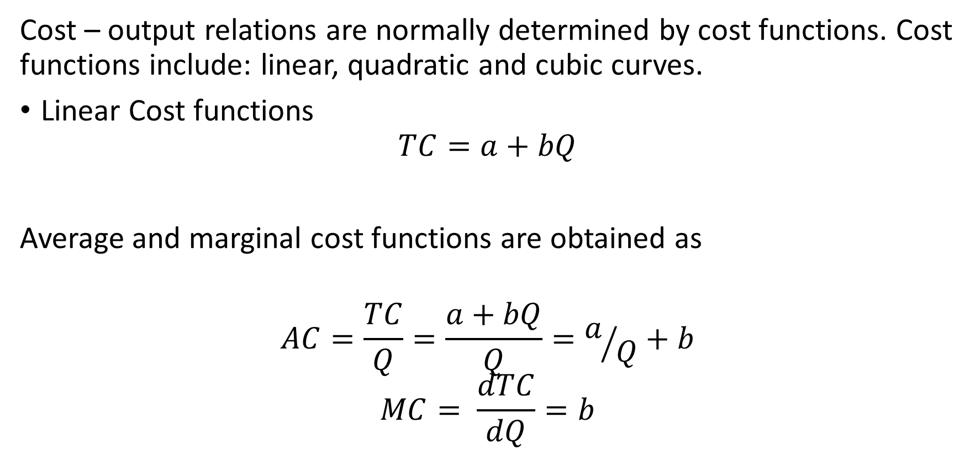
Cost Functions
Where a = Total fixed cost
bQ = Total variable cost

Slide 38
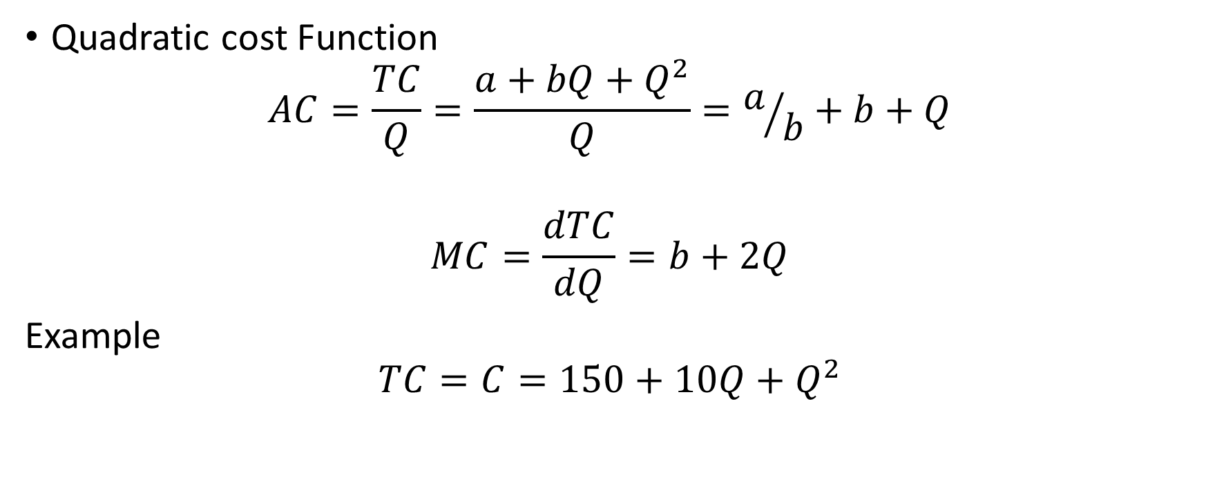
Cost Function Cont’d

Slide 39
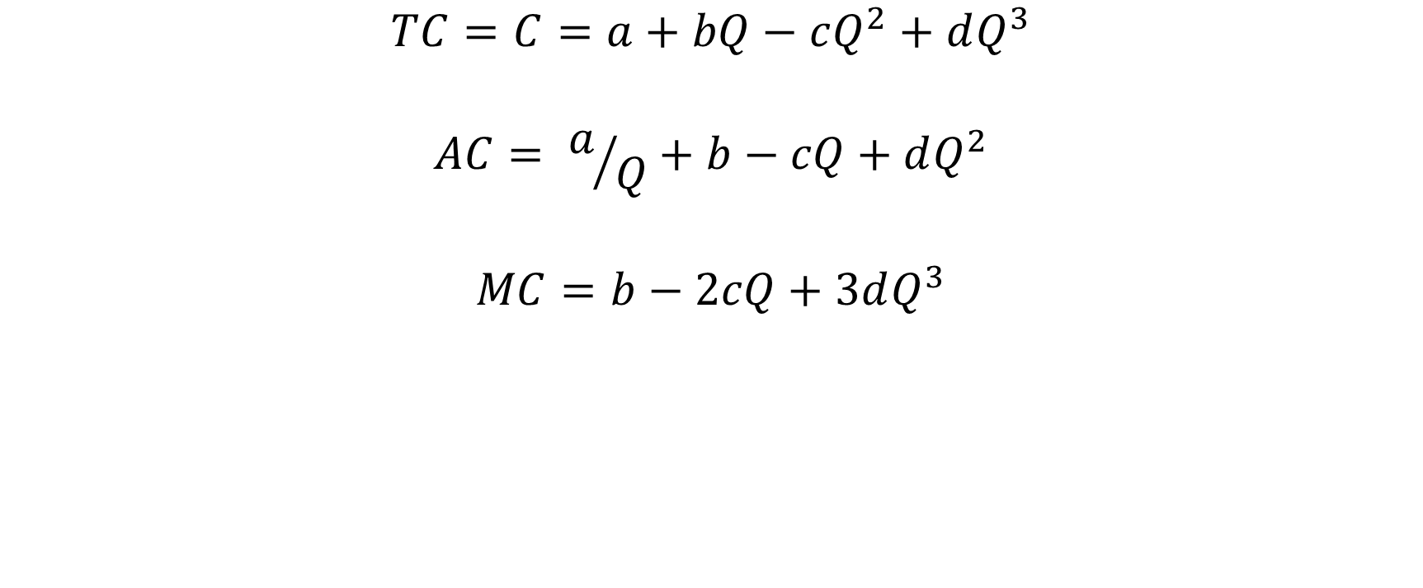
Cubic Cost Function

Slide 40
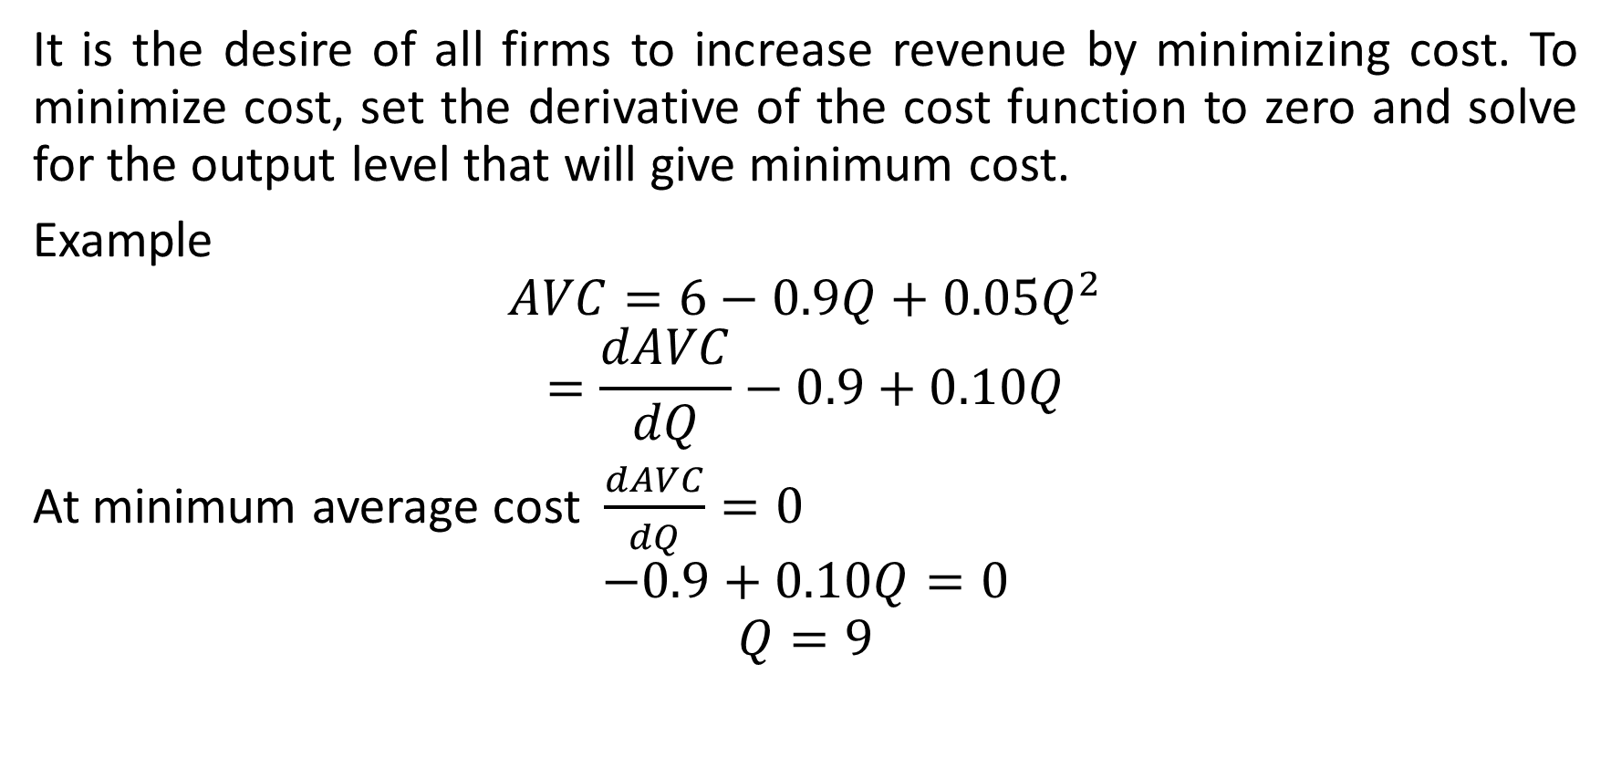
Cost Minimization

Slide 41
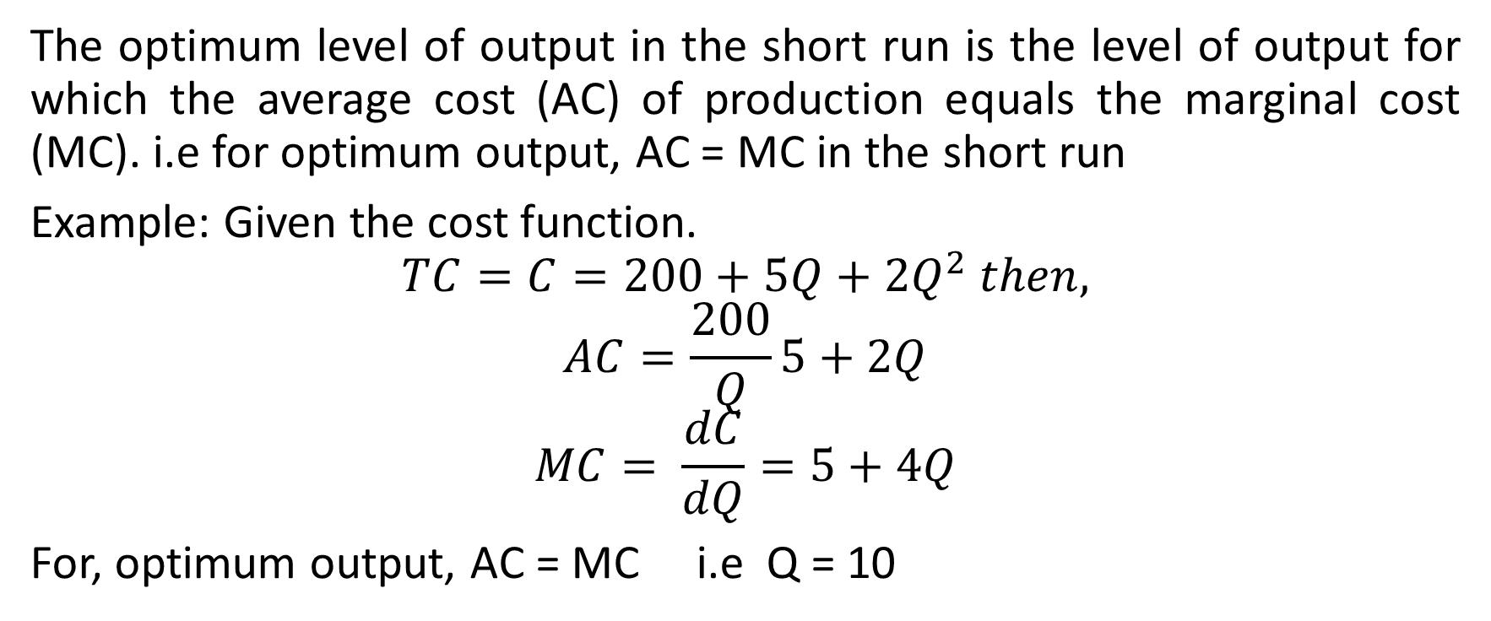
Output optimization in short run

Slide 42
Revenue
Refers to receipts of a firm from sales of a given amount of good/commodity. Revenues are cash inflows as against costs which are expenses.
Frequently studied revenues include total revenue, average revenue and marginal revenue.
Total revenue represent total income of a firm obtained by multiplying the quantity of commodity sold by the price of the commodity.

Slide 43
Average revenue is the revenue per unit of product sold. It is obtained by diving total revenue by quantity of commodity sold. Average revenue is equivalent to the unit price of the commodity
Marginal Revenue is the extra (additional) revenue obtained from selling an extra unit of the commodity. It is expressed as:
MRj = TRj – TRj-1

Slide 44
MRj= Marginal Revenue of jth unit; TRj = Total revenue of jth unit; TRj-1 = Total revenue from J-1 unit (MR10 = TR11 –TR10). It is the change in total revenue divided by change in number of units.

Slide 45
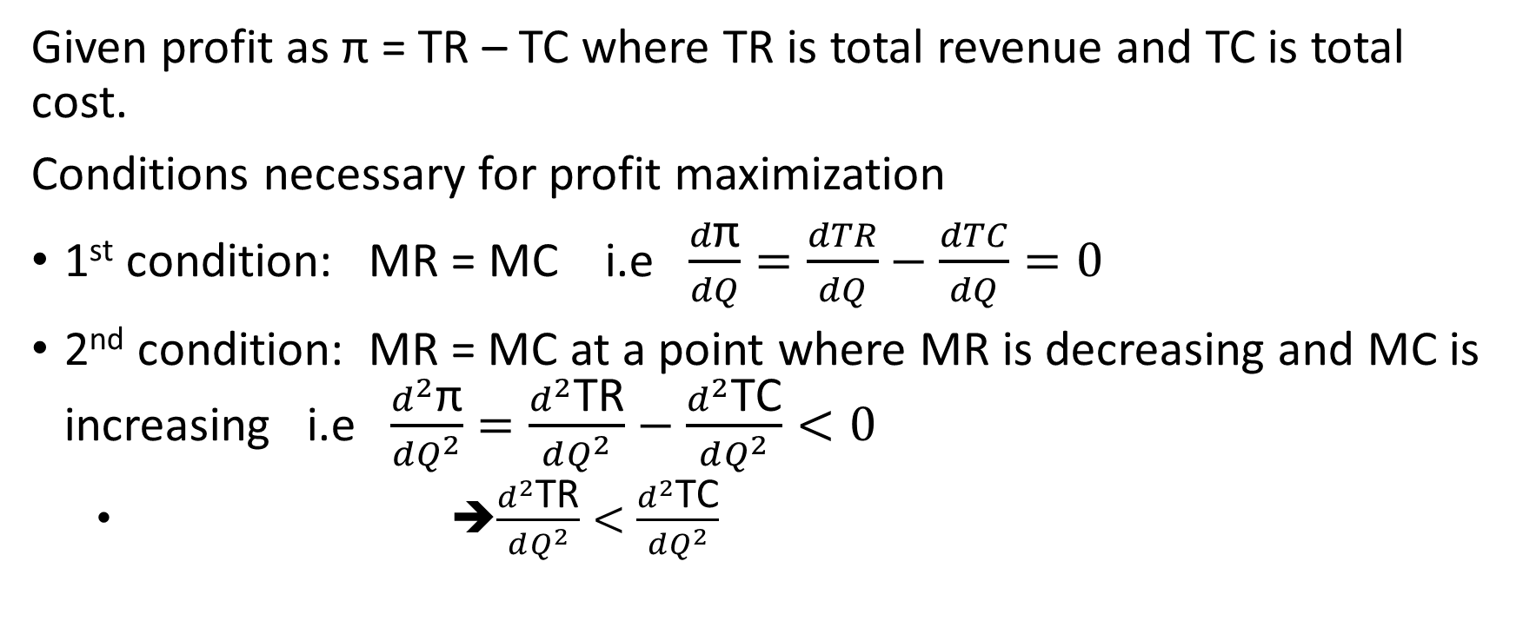
Maximization of profit

Slide 46
Break Even Analysis
Break even analysis is a useful and frequently employed technique for determining the volume of service/goods needed to ensure that revenue generated will exceed costs. Break even is attained when total revenue (TR) is equal to total cost (TC)
TR
TC
Cost / Revenue
FC
A
Volume of goods / services

Slide 47
Cont’d (Relevant equations)
TR = REV X N
VC = COST X N
TC = VC + FC
TR = Total Revenue
REV = Revenue generated per unit service
N = Number of unit or service provided
VC = Variable cost
TC = Total cost
FC = Fixed cost

Slide 48
Break Even Analysis Example
Pen Sold (Q) | 20 000 | 50 000 | 80 000
Total Sales (S) | 400 000 | 1 000 000 | 1 600 000
Variable Cost (V.C) | 240 000 | 600 000 | 960 000
Contribution Margin (CM) | 160 000 | 400 000 | 640 000
Fixed Cost (FC) | 400 000 | 400 000 | 400 000
Profit/Loss | 240 000 | 0 | 240 000

Slide 49
Week 6: Time Value of Money (TVM)
It is a financial management concept that is used to compare investment alternatives and to solve problems involving loans, mortgages, leases, savings and annuities. It works on the concept that a unit amount of money received today is worth more than the promise or expectation of the same amount in future.

Slide 50
Terminologies
Interest: amount paid on loan or gained for deposit
Cash Flow: total amount of money being transferred in and out of business
Present value: Current value of future payment at a given rate of return.
future worth: It is the value of a current asset/amount at a specified date in future.

Slide 51
Annuity: Series of equal payment or receipt
Amortization: Method of loan payment by instalment
There are standard tables where values can be read. Calculation can also be done using formula method.
See other documents for applications of TVM, problems and worked examples.

Slide 52
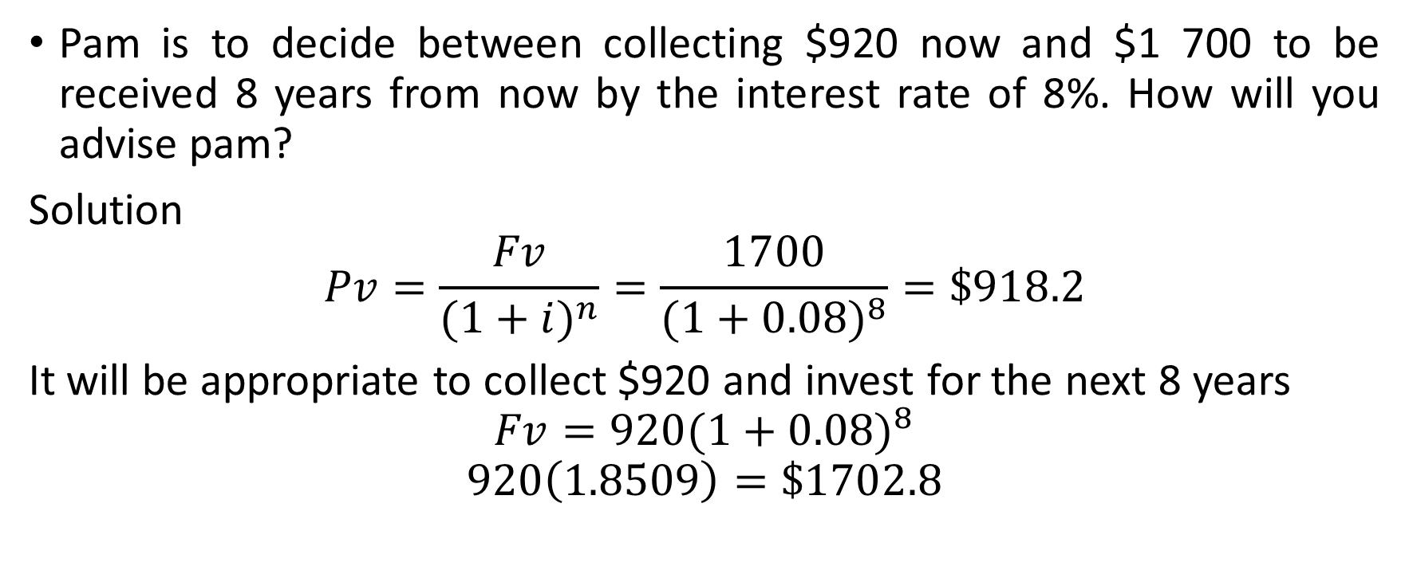
Example

Slide 53
Week 7: Concept of Depreciation
Definition: This is the diminution in the value of a fixed asset. It occurs in systematic manner of a period of time until the value becomes negligible. The value of the asset after its useful life is called salvage or scrap value of end of life value.

Slide 54
The purpose of depreciation is to match cost of a fixed asset over its productive life to the revenues that the business obtains as a result of deploying the asset. It helps to know when to replace the asset. Depreciation is charged due to age, wearing and tearing, perishability (product with short life span), usage right (usage right of some product is only for some time), natural resource depletion, inefficiency and obsolescence etc

Slide 55
Depreciation can be charged by:
Straight line method, Double declining method, some of digit methods, sinking fund method etc.
Some useful information in calculating depreciation include: Useful life (productive life of assest); Salvage value (Post useful life value); cost of the asset (inclusive of tax shipping, installation)

Slide 56
Straight line method: By far the simplest approach using even rate of depreciation every year through out the useful life of the asset. It is computed as:
(Asset Cost – Residue Value)/ Useful Life of Asset
Example: If the cost of an equipment = #800,000, Useful life =10 years, Residual Value = #50,000. Find the annual depreciation expense.

Slide 57
Using straight line method, annual depreciation expense = (800,000-50,000)/10 = #75,000

Slide 58
Unit Production Method
It is a two- stage method as against one used for straight line depreciation. Equal expense rates are assigned to each unit of product. The calculation is thus based on output capability of the asset as against number of years. The steps involved are:

Slide 59
Determine the depreciation per unit as (asset Cost – Residual Value)/ Useful life expressed as units of production
The second stage is the computation of total depreciation of actual units produced as Per Unit Depreciation X Units Produced)
Example: If the cost of production equipment was 50,000 with a useful life of 180,000 units and residual value of #4000. if it produced 5000 units of products, find the total depreciation.

Slide 60
Per Unit Depreciation = (50,000 – 4,000)/180,000 = #0.2
Total Depreciation expense = #0.2 * 5000 units = #1000. The total depreciation is #1,000
Double declining method: It is one of the commonest methods used to account for expenses of a fixed asset. It is an accelerated depreciation method. Expenses is counted twice as much as the book value of the asset every year.

Slide 61
Depreciation = 2* Straight line depreciation percent* book value at the beginning of accounting period.
Book Value = Cost of Asset – Accumulated Depreciation
Accumulated Depreciation represents the total depreciation of an asset accumulated up to a specified time.

Slide 62
Example: On April 1, 2012, Adex Electrical Ltd purchased an equipment for #100,000 which was expected to have useful life of 5 years. The scrap value was #10,000. Depreciation is considered to the nearest whole month. Find the expenses for 2012, 2013 and 2014.
Useful Life = 5 years
Straight line depreciation percent =1/4 = 0.2 0r 20% per year
Depreciation rate 20% * 2 = 40% per year
For 2013, Depreciation = 100,000*40% *9/12 = #30,000

Slide 63
Depreciation for 2013 = (100,000- 30,000)*40%*12/12 = #28,000
Depreciation for 2014 = (100,000-30,000-28,000)*40%*9/12 =16,800

Slide 64
Week 8: Business Integration, Diversification/ Combination
Business Integration:
This involves among other things, the synchronisation of information technology and business culture and objectives. It is absorption of IT as a business function.

Slide 65
Business diversification/Combination
This is a form of corporate strategy for a company which seeks to increase profitability through greater sales volume obtained from new products and new markets.
Business combinations are combinations formed by two or more business units with a view to fulfil common aim. They can be loose or well consolidated combinations.

Slide 66
Reasons for Combination:
It strengthens ability to compete
Good will (Respect for size) arising from economics of large scale organisation
It brings up technical, managerial, economic and marketing advatages
Ability to withstand fluctuation and risk is enhanced
Desire for monopoly

Slide 67
Business Cycles: combination may assist to survive difficult or down times
Joint Stock: Major share holders who acquire power of control
Imposition of tariff: Combination takes place for survival

Slide 68
Types of combination
Horizontal
Vertical
Lateral or Allied: Can be convergent or divergent. In convergent combination, different unit supplying a major firm may combine with the major firm. Ink and paper supplier combining with printing press. In divergent, major firm supplies its products to firms which use it as raw material. E.g Steel company supplying tubing, wire nail firms etc

Slide 69
Mixed or Circular Combination: Firms producing different products combined.
Forms of combination: Refers to degree of looseness or consolidation.
These forms are:
Associations: which may be trade association, chamber of commerce or informal agreement
Federation: cartel or pool
Consolidation: partial or complete

Slide 70
In trade associations, units which engage in a particular business meet to promote their business. The meeting is usually non profit basis but discussion on problems affecting them e.g tax, laws, raw material etc. They occur mostly at local levels.
Chambers of Commerce though voluntary involves professionals of diverse background not restricted to a particular trade viz bankers, brokers, industrialists etc. they form business community in a country and can advise government.Informal agreement is usually done to regulate production, apportion market, fix price. It requires surrendering some freedom.

Slide 71
In pool/cartel members come together to regulate demand and supply without surrendering their entities in order to control price.
Consolidation can be partial or complete. In partial approach, freedom is surrendered but entity is retained. Complete consolidation include merger and amalgamation. In merger (acquisition) some units merge with another existing unit to form bigger entity. The units loose their entity while the absorbing firm retains it entity. In amalgamation, all units give way for a new entity to be formed.

Slide 72
Week 9: Demand Forecasting
A forecast is a prediction or estimation of a future situation, under given conditions. Demand forecast helps managers to make the following decisions effectively.

Slide 73
Short Run Decision | Long Run Decision
Purchase of inputs | Expansion of existing capacity
Maintenance of economic level of inventory | Diversification of the product mix
Setting up sales targets | Growth of acquisition
Distribution network | Change of location of plant
Management of working capital | Capital Issue
Price policy | Long run borrowing
Promotion policy | Manpower planning

Slide 74
Steps to be followed:
Identification of objectives
Nature of product and market
Determination of demand
Analysis of factors
Choice of Technology
Testing of Accuracy

Slide 75
Criteria for choice of forecasting
Accuracy
Plausibility
Durability
Flexibility
Availability

Slide 76
Forecast methods
Survey of buyer’s intention
Delphi method
Expert opinion
Collection opinion
Waive model
Smoothing technique
Time series / trend projection
Controlled experiments
Judgemental approach

Slide 77
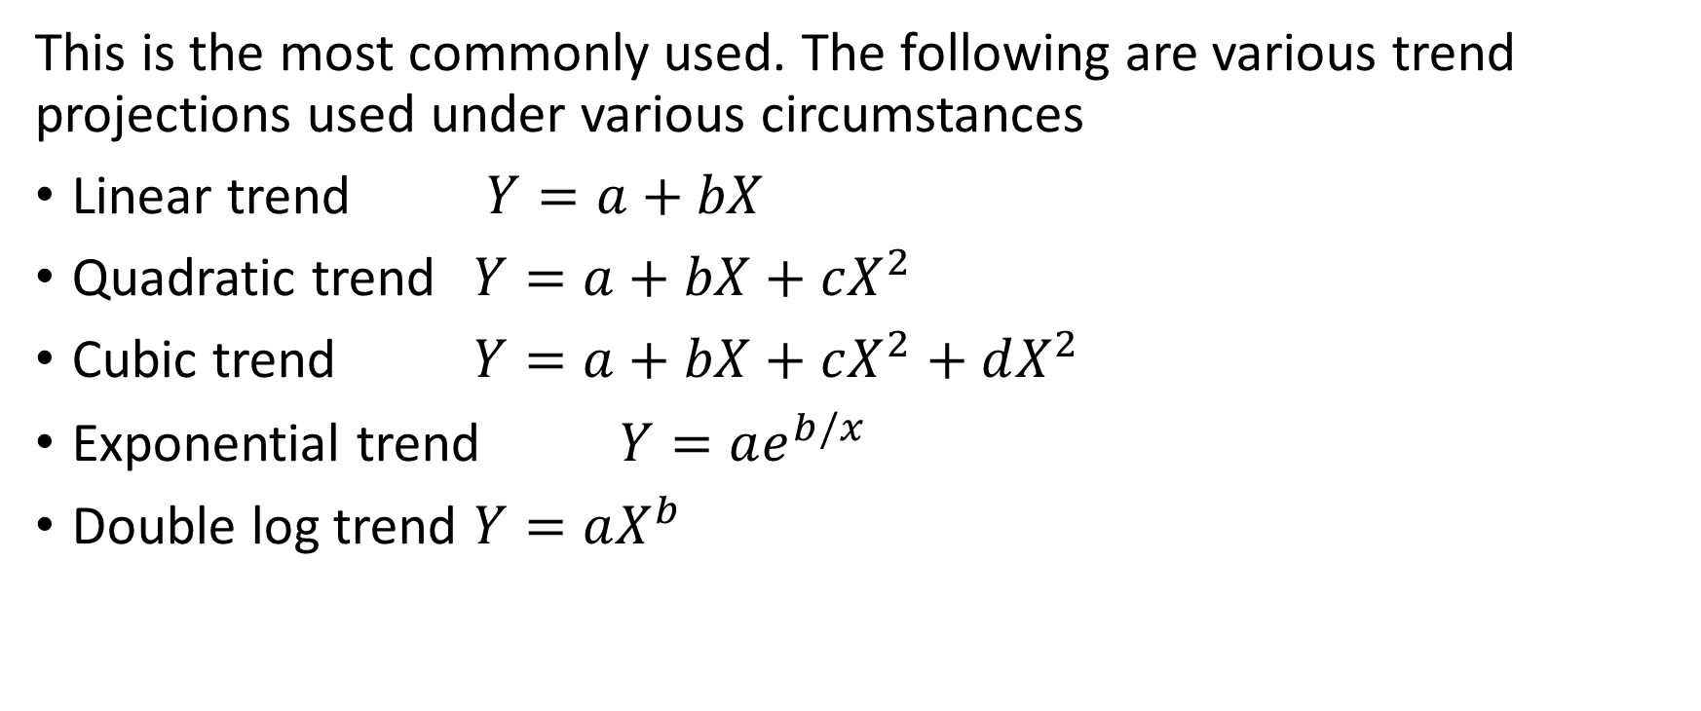
Time series / Trend projection

Slide 78
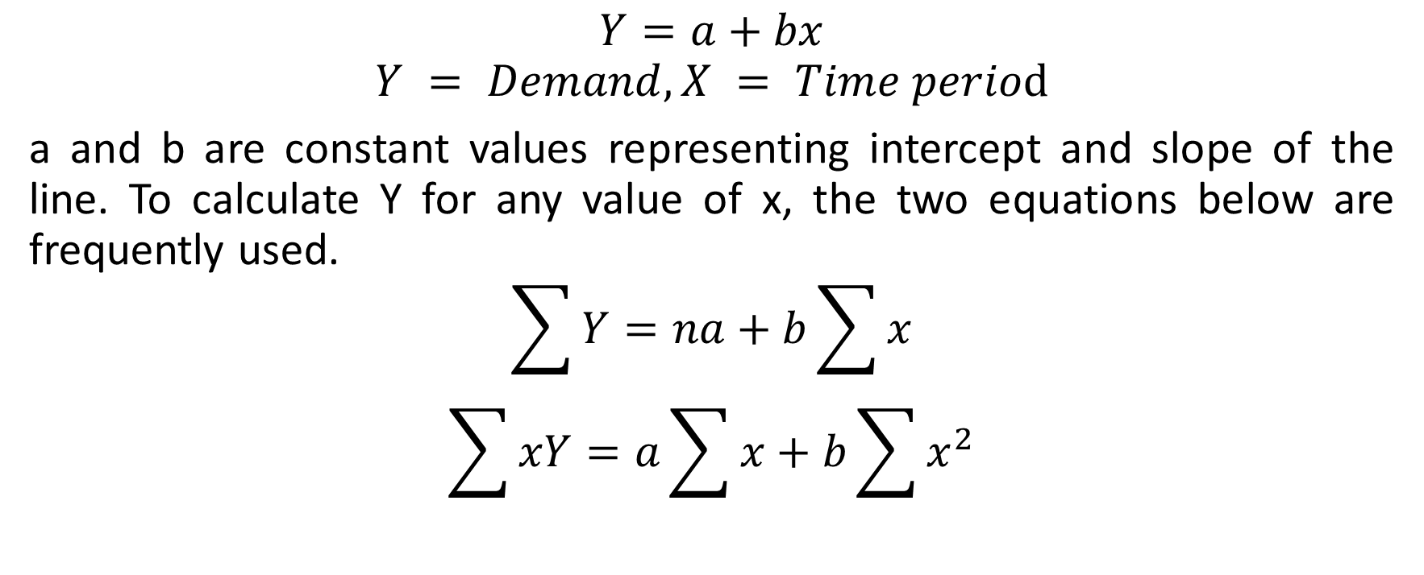
Linear Trend Equations

Slide 79
Example
Year | 2002 | 2003 | 2004 | 2005 | 2006 | 2007 | 2008 | 2009 | 2010 | 2011
Sales | 22734 | 24731 | 31489 | 44685 | 55319 | 91021 | 146234 | 107887 | 127483 | 97275
Estimate the sales for 2012 and 2015

Slide 80
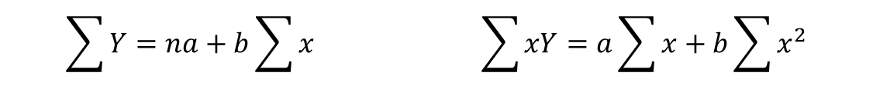
Solution
year | x | sales (Y) | XY | X²
2 | 1 | 22734 | 22734 | 1
3 | 2 | 24731 | 49462 | 4
4 | 3 | 31489 | 94467 | 9
5 | 4 | 44685 | 178740 | 16
6 | 5 | 55319 | 276595 | 25
7 | 6 | 91021 | 546126 | 36
8 | 7 | 146234 | 1023638 | 49
9 | 8 | 107887 | 863096 | 64
10 | 9 | 127483 | 1147347 | 81
11 | 10 | 97275 | 972750 | 100
sum | 55 | 748858 | 5174955 | 385

Slide 81
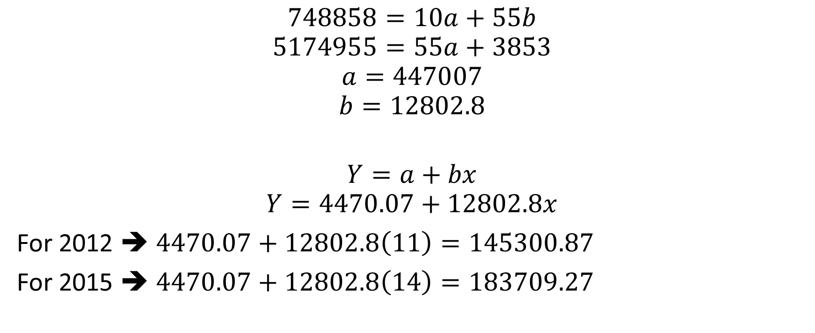
Soln cont’d

Slide 82
Trend in Series
Sales
* Sales (Y)
- Linear Sales (Y)
Year

Slide 83
Forecasting cont’d
Stationary series
Naïve method
Simple average method
Moving average method
Autoregressive moving average
Box Jenkins method
Forecasting trend series
Moving average
Simple regression
Growth curves
Exponential models
Autoregressive integrated moving average (ARIMA) models
Box Jenkins method
Seasonal series
Exponential smoothing
Multiple regression
Arima
Cyclical Series
Econometric models
Multiple regression
Arima

Slide 84
Forecasting cont’d
Other survey methods are:
Complete enumeration method
Sample survey method
Expert’s opinion

Slide 85
Week 10: Location and Localization of Industries
Location refers to the physical location of a company. It while localization refers to the efforts of companies to tailor their products to certain region. It is the tendency for industries to be concentrated in regions that offer certain advantages
Causes of Localization
Availability of power
Availablity of raw material
Climate
Availability of skilled labour
Nearness to market
Availability of means of transportation and communication

Slide 86
Advantages of Localization
Growth and development of skills
Growth of local market
Reputation and good will
Growth of subsidiary industries
Growth of supplementary and allied industries

Slide 87
Week 11: Distributive Trade
Definition
It essentially refers to the distribution part of production. It is also referred to as channels/processes of distribution.
It means various channels by which goods reach the end users/ consumers
Production is not complete until it reaches consumers.

Slide 88
The pattern of distributive trade is as shown:
Manufacturer– Wholesaler- Retailer – End user (consumer)
Wholesaler: This is involved in bulk purchasing, information transfer, warehousing, financing, transportation, branding, repackaging and grading etc

Slide 89
Retailer: Functions as final link to end users, information carrier, sales of good directly to consumers, buys and sells smaller units, makes goods to reach interior and very remote areas.
Roles of Cooperative Society in Distributive Trade: Purchase from manufacturer or wholesaler and selling to members at reduced prices. They stock variety of goods; sell in minute quantities to members; grant credit facilities to members; offer advice; bring commodities closer to members; restrict hoarding tendencies, eliminates middle men and retailers etc

Slide 90
Role of Government:
Government at all levels have tremendous roles in distributive trade. Agencies like Nigerian National Supply Company Limited, Imo distributive Agency and some other ones which have ceased to exist etc are attempts of government in this regard. Other roles of government include provision of storage facilities, price stabilization and control, prevention of hoarding and artificial scarcity, facilitating transportation etc

Slide 91
Challenges of Distributive Trade: These include hoarding, inadequate storage facilities, problem of several layers of middle men, poor transport facilities, market volatility and uncertainties, insufficient credit facilities

